Slide 1
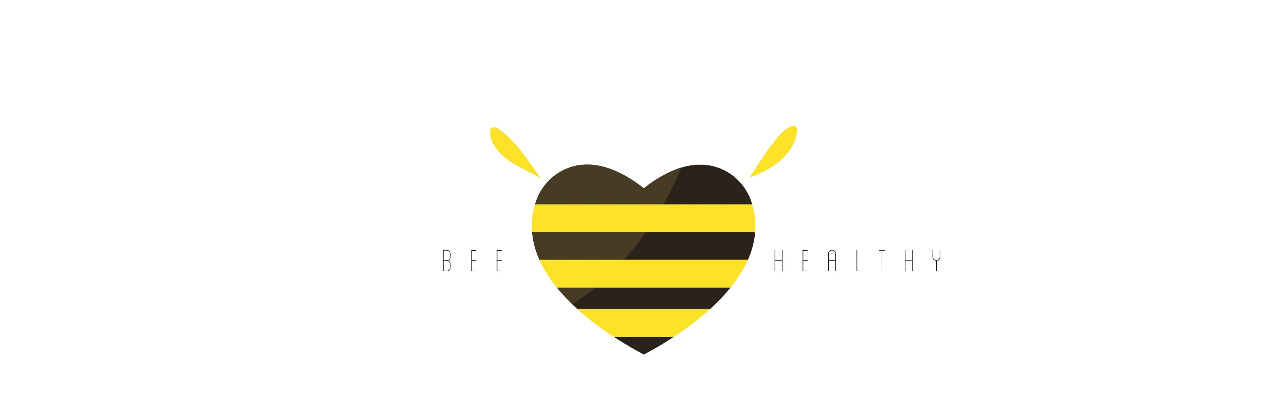

Slide 2
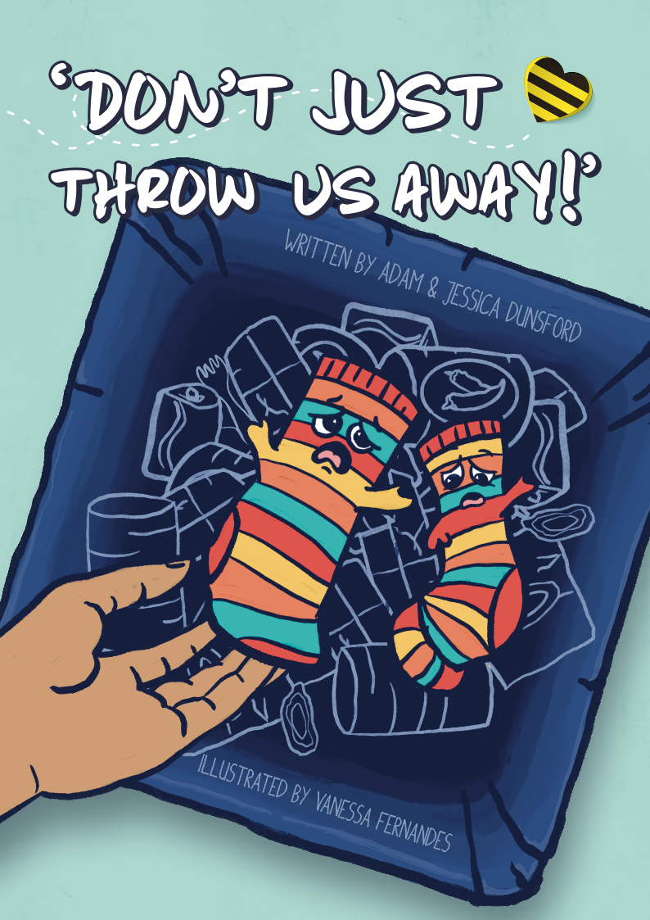
Lesson 1
Learning Objective: To understand what is meant by textiles
I can name different textiles
I can explain where different textiles come from

Slide 3
What Are Textiles?
Textiles are flexible materials made by creating an interlocking network of yarns or threads. Common examples include clothes, bed sheets, tea towels and bags. Different materials can make up textiles.
Where do we get our materials from to make all these different textiles?

Slide 4
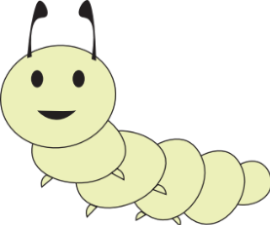

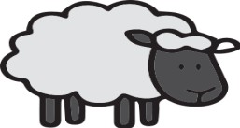
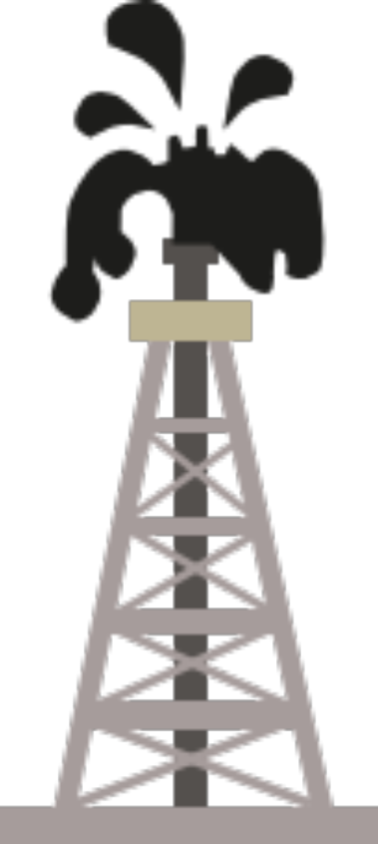
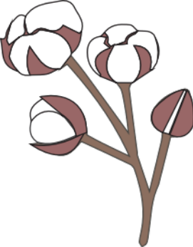

Where do textiles originally come from?
The materials we use can come from different places. Can you list some ideas of where you think they might be. Then click and reveal the answers under the yellow boxes.
Wool
Wool comes from a sheep’s coat.
Leather
Leather comes from the skin of some animals.
Silk
Silk comes from silk worms.
Bamboo and trees:
Cellulose is squeezed from the plants and then turned into fibres through a special process.
Cotton:
Cotton comes from cotton plants.
Synthetic Materials:
These materials are made from crude oil such as Polyester, Nylon and Acrylic. It is estimated around 65% of textiles are made from synthetic materials.
But how are they actually made?

Slide 5
Wool:
Wool comes from sheep. Farmers shave all the wool off the sheep known as shearing. Usually an adult sheep is sheared at least once a year.
The wool is then sent to a factory and cleaned through a process known as scouring. Once it is clean it is then left to dry and then sent through a number of steps where the fibres are thinned and spun around very tightly to make a strong thread.
The thread is then wound up into reals of wool which can then be used to make all sorts of clothing.
Check out how sheep’s wool is turned into clothes with this great video.

Slide 6
Leather:
Leather can be made from the skin of almost any animal however the most common is cows.
The skin is cleaned and dried and can then be shaped and cut into specific clothing or products such as wallets, bags, shoes, belts and watch straps.

Slide 7
Silk:
Silk is created from silk worms. The silk worms spin themselves into a cocoon using the silk fibres they produce. The worms hatch from the cocoons and become beautiful moths.
The cocoons are then put into boiling water and stirred until the silk unravels.
The silk is then collected by wrapping it tightly into reels and will then go through the process of dyeing to give it a new colour.
From here it will be spun and weaved to make it into pieces of strong silk which can be used to make new clothes or bed sheets.

Slide 8
Cotton:
Cotton comes from cotton plants.
Firstly, it is handpicked or now commonly collected by a machine. The cotton balls are then put into a ‘gin’ where the cotton is separated from the seeds.
The cotton then goes through a process of spinning and it is finely combed and put into loose strands.
Finally, it is soaked and bleached and will then be dyed into particular colours.

Slide 9
Bamboo:
Bamboo is taken to mills where they are crushed and submersed in a strong solution of sodium hydroxide which dissolves the bamboo cellulose.
A chemical called Carbon disulfide is then added which helps the process of extracting the bamboo fibres. The fibres are then washed and bleached to a bright white colour and dried. It is then spun into yarn, like any other textile fibre. This can then be used to make textiles such as clothing.
Bamboo is favoured to be more sustainable as bamboo can grow so quickly. It can grow up to 20 metres in just three months.

Slide 10
Synthetic Materials:
These materials are made from crude oil such as Polyester, Nylon and Acrylic. It is estimated around 65% of textiles are made from synthetic materials.
The oil is pumped out of the ground and then will go through a number of processes to be made into the specific fibres to be used.
One such process is called polymerisation this allows the scientists to create their specific material they need.

Slide 11
Did any of these surprise you?
Wow! Who would’ve thought that is where our clothes are from and the process they go through to be made!
Did any of these discoveries surprise you? Share with the person next to you or the class if you have discovered something new.
But wait there is more!

Slide 12
Additional Materials
As technology and innovation gets better and better we are able to find new ways to make textiles. Here are a few more that is now being used more commonly and some are known to be better for the environment.
Hemp is Known to be the most environmentally friendly alternative as it requires less water than cotton, grows without pesticides and absorbs a lot of carbon.
Pineapples are the new way to make leather. The pointy leaves of the pineapple have the fibres extracted through a process called decortication.
Econyl is made from plastic pollution that comes from the ocean such as fishing nets. Fishing nets make up for 40% of plastic waste in our ocean.
Check out this video about how some shoes and clothes are made from recycled plastic bottles

Slide 13
Activity
What material are your clothes made from?
Check the labels in your clothing, bags and shoes and see if you can identify what your items are made from.
Write them down on the worksheet provided.

Slide 14
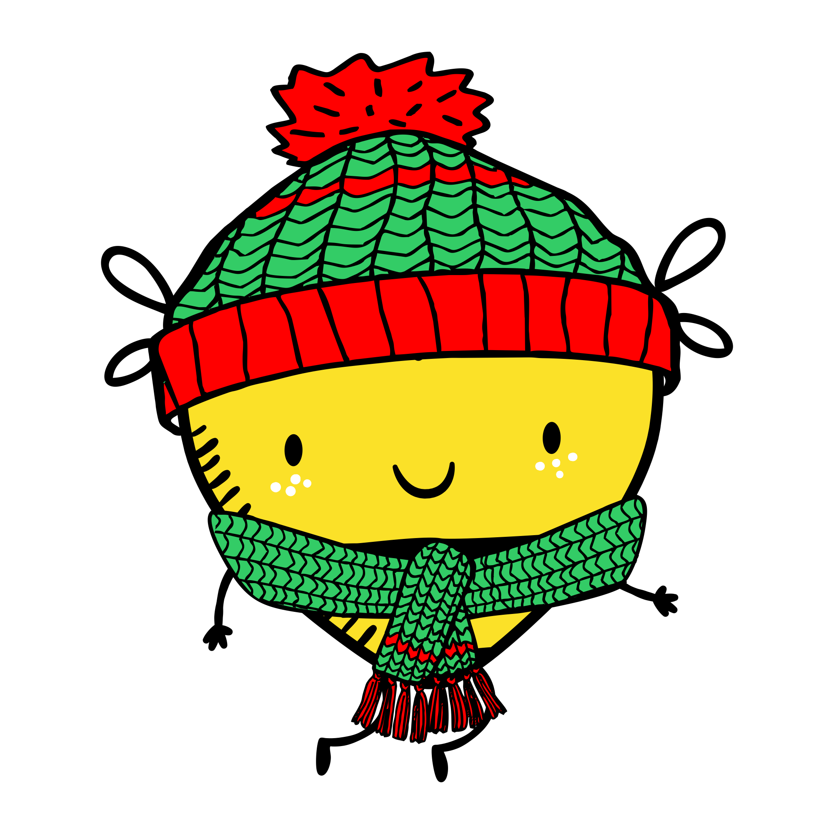
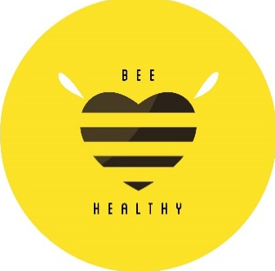
Plenary
What are the different types of textiles?
Name one and explain how it is made?
What do you think some of the problems with making so many textiles might be?

Slide 15
Australian Curriculum Objectives
The Sustainability cross-curriculum priority
Sustainability addresses the ongoing capacity of Earth to maintain all life.
Sustainable patterns of living meet the needs of the present without compromising the ability of future generations to meet their needs. Actions to improve sustainability are individual and collective endeavours shared across local and global communities. They necessitate a renewed and balanced approach to the way humans interact with each other and the environment.
Education for sustainability develops the knowledge, skills, values and world views necessary for people to act in ways that contribute to more sustainable patterns of living. It enables individuals and communities to reflect on ways of interpreting and engaging with the world. Sustainability education is futures-oriented, focusing on protecting environments and creating a more ecologically and socially just world through informed action. Actions that support more sustainable patterns of living require consideration of environmental, social, cultural and economic systems and their interdependence.
Sustainability is one of the three cross-curriculum priorities stipulated by the Australian Curriculum. Click on the link to view the overview of sustainability in the Australian curriculum.

Slide 16
PSHE – Programme of Study (UK)
KS1 Learning opportunities in Living in the Wider World
Pupils learn...
L2. how people and other living things have different needs; about the responsibilities of caring for them
L3. about things they can do to help look after their environment
KS2 Learning opportunities in Living in the Wider World
Pupils learn...
L3. about the relationship between rights and responsibilities
L4. the importance of having compassion towards others; shared responsibilities we all have for caring for other people and living things; how to show care and concern for others
L5. ways of carrying out shared responsibilities for protecting the environment in school and at home; how everyday choices can affect the environment (e.g. reducing, reusing, recycling; food choices)

